Slide 1
CHGM-141
General and Analytical Chemistry I
Lecture 9
(Ch. 3)
with Dr. Bailey
Ionic Compounds
ION SIZES
IONIC COMPOUNDS FORMULAS, NAMES

Slide 2

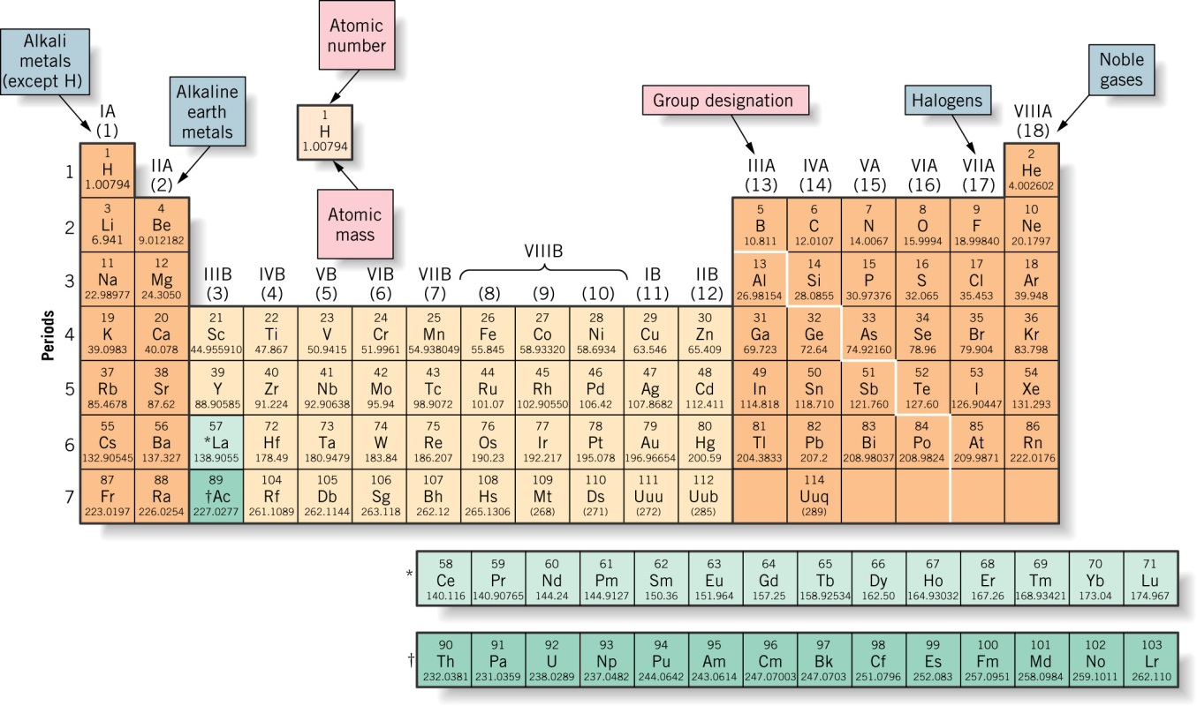
Compare the elements Na, B, Al, and C with regard to the following properties:
Which has the largest atomic radius?
10
Na
B
Al
C
0
of
5

Slide 3
Compare the elements Na, B, Al, and C with regard to the following properties:
Which has the largest atomic radius?
10
Na
B
Al
C
Navigation!
0
of
5

Slide 4

Atomic Size
What we know:
Size goes UP on going down a group.
Because electrons are added further from the nucleus, there is less attraction.
Size goes DOWN on going across a period owing to increase in Z*.
Each added electron feels a greater and
greater + charge.

Slide 5
Ion Sizes

Slide 6
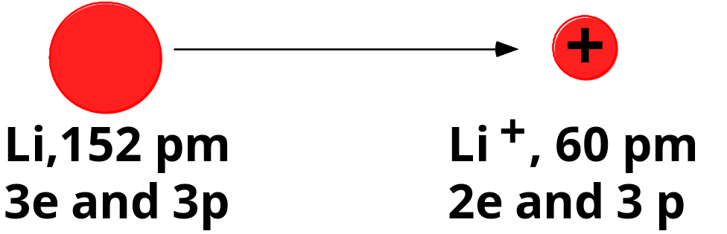
Ion Sizes
Does the size go
up or down when losing an electron to form a cation?

Slide 7
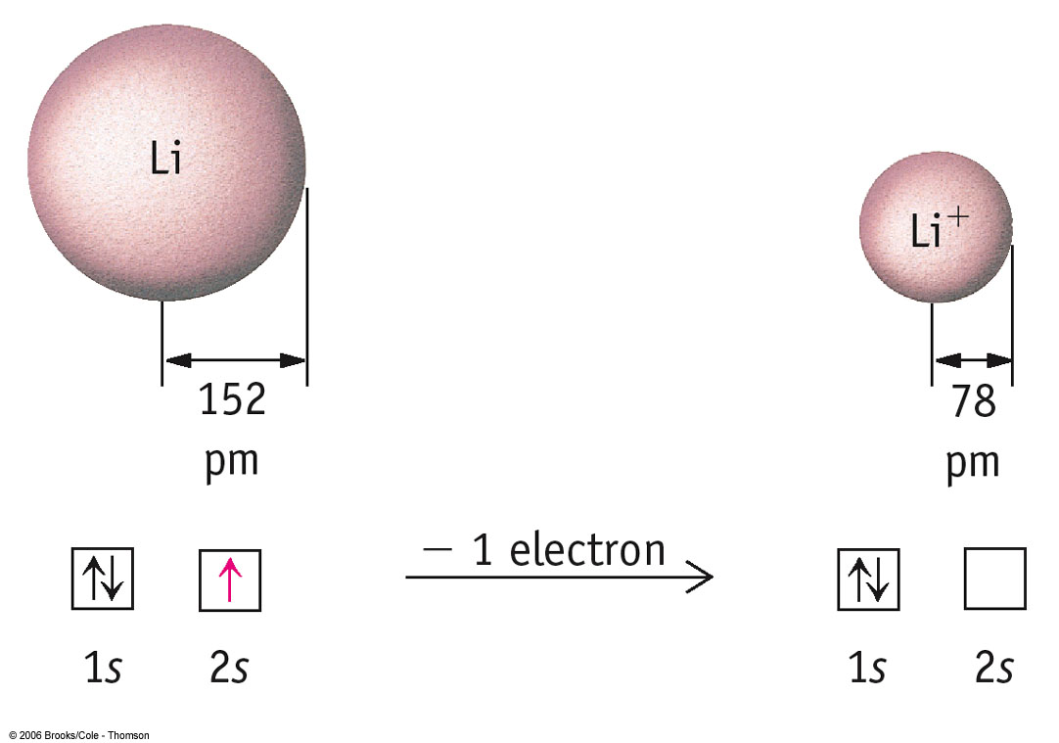

Slide 8
Ion Sizes
+
Forming a cation.
Li,152 pm
Li
+
, 78 pm
3e and 3p
2e and 3 p
CATIONS are SMALLER than the atoms from which they come.
The electron/proton attraction has gone UP and so size DECREASES.

Slide 9
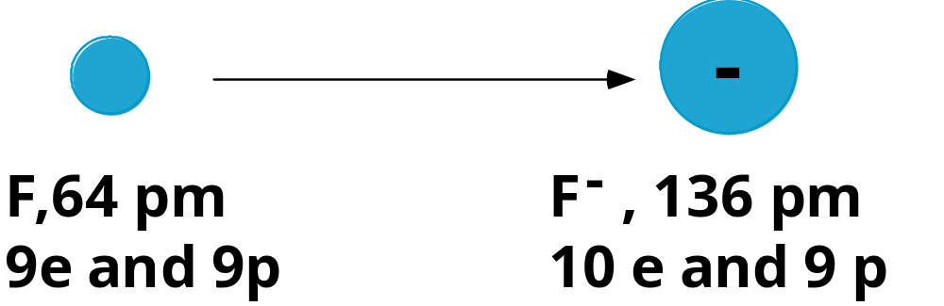
Ion Sizes
Does the size go up or down when gaining an electron to form an anion?

Slide 10
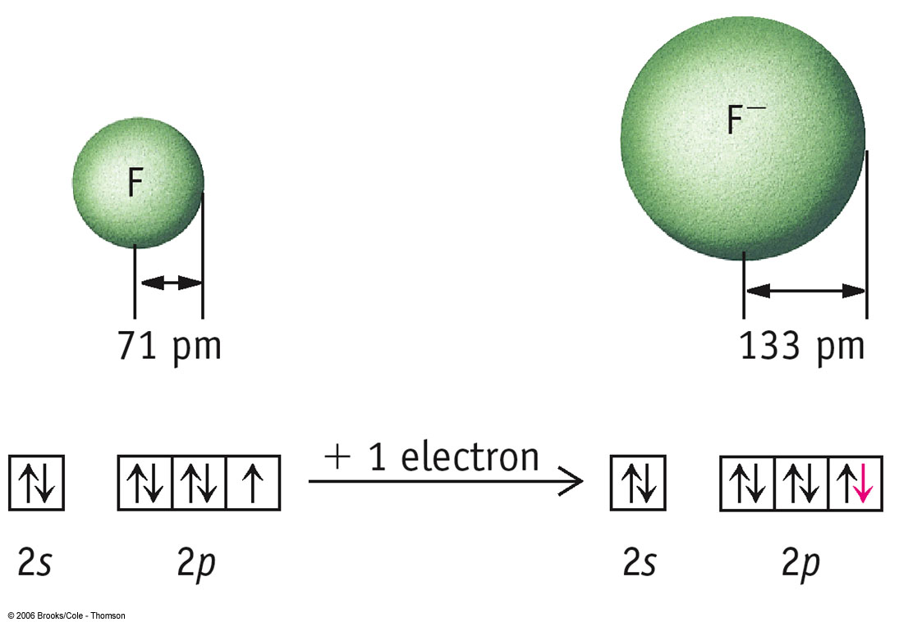
p.363

Slide 11
Ion Sizes
-
Forming an anion.
F, 71 pm
F
-
, 133 pm
9e and 9p
10 e and 9 p
ANIONS are LARGER than the atoms from which they come.
The electron/proton attraction has gone DOWN and so size INCREASES.

Slide 12
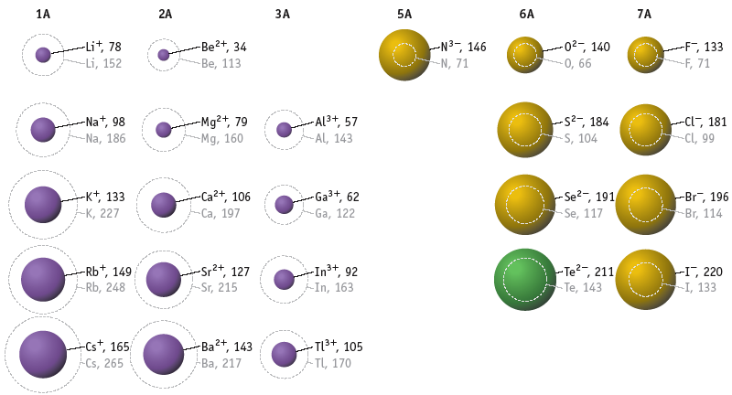
Trends in Ion Sizes
Trends in ion sizes are the same as atom sizes.

Slide 13
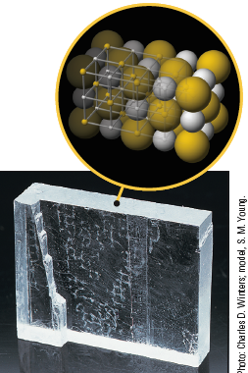
COMPOUNDS FORMED FROM IONS
CATION +
ANION --->
COMPOUND
Na⁺ + Cl⁻ --> NaCl
A neutral compd.
requires
equal number of +
and - charges.

Slide 14
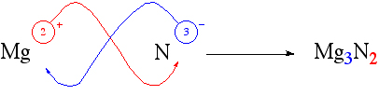
Writing Formulas
A neutral compd.
requires
equal number of +
and - charges.
Rules for writing Formulas of Ionic Compounds:
  The charge on the cation becomes the subscript on the anion.
  The charge on the anion becomes the subscript on the cation.
  The positive ion is given first in the formula.
  The subscripts in the formula must produce an electrically neutral formula unit.
  The subscripts should be the set of smallest whole numbers possible. If these subscripts are not in the lowest whole-number ratio, divide them by the greatest common factor.
  The charges on the ions are not included in the finished formula of the substance.
2009, Prentice-Hall, Inc.

Slide 15
Let’s pick some Examples…
MgO
MgO is a perfect example of a metal/non-metal compound.
Mg gives up 2 electrons to form Mg²⁺
O accepts 2 electrons to form O²⁻
Mg²⁺ and O²⁻ are attracted to each other.

Slide 16
Naming Ionic Compounds
It is very simple to name an ionic compound:
Name the metal first
Name the non-metal second
Add “-ide” to the root of the non-metal
MgO - magnesium oxide

Slide 17
Naming Ionic Compounds
Examples
Ionic Compound: A neutral compound in which the total number of positive charges must equal the total number of negative charges.
sodium chloride:
Na⁺
Cl–
NaCl
magnesium oxide:
Mg²⁺
O^{2–}
MgO
aluminum sulfide:
Al³⁺
S^{2–}
Al₂S₃

Slide 18
Naming Ionic Compounds
Examples
NaF – sodium fluoride
NaCl – sodium chloride
Na₂O – sodium oxide
Fe₂O₃ - ?
FeO - ?

Slide 19
Naming Ionic Compounds Specifying the charge
Use Roman numerals in parentheses to indicate the charge on metals that form more than one kind of cation.
iron(III) oxide:
Fe³⁺
O^{2–}
Fe₂O₃
tin(II) chloride:
Sn²⁺
Cl–
SnCl₂
lead(II) fluoride:
Pb²⁺
F–
PbF₂

Slide 20
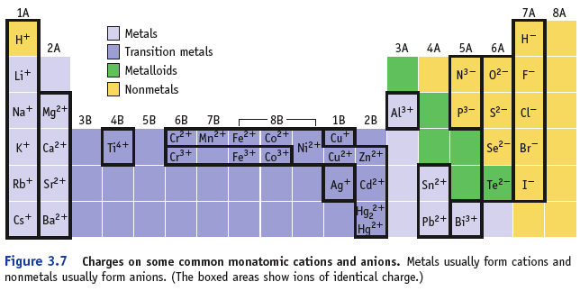
Predicting Charges on Monatomic Ions

Slide 21
Determining the Charge on a Cation with Variable Charge – Au₂S₃
determine the charge on the anion
  Au₂S₃ - the anion is S, since it is in Group 6A, its charge is -2
determine the total negative charge
  since there are 3 S in the formula, the total negative charge is -6
determine the total positive charge
  since the total negative charge is -6, the total positive charge is +6
divide by the number of cations
  since there are 2 Au in the formula and the total positive charge is +6, each Au has a +3 charge

Slide 22
Example – Naming Binary Ionic with Variable Charge Metal
CuF₂
Identify cation and anion
  F = F⁻ because it is Group 7
  Cu = Cu²⁺ to balance the two (-) charges from 2 F⁻
Name the cation
  Cu²⁺ = copper(II)
Name the anion
  F⁻ = fluoride
Write the cation name first, then the anion name
  copper(II) fluoride

Slide 23
Another example
MnO₂
What would you name it?
Mn = manganese
So it is manganese (?) oxide
Oxygen– usually -2, so Mn must be +4

Slide 24
Example – Writing Formula for Binary Ionic Compounds Containing Variable Charge Metal manganese(IV) sulfide
Write the symbol for the cation and its charge
Write the symbol for the anion and its charge
Charge (without sign) becomes subscript for other ion
Reduce subscripts to smallest whole number ratio
Check that the total charge of the cations cancels the total charge of the anions
Mn⁺⁴
S²⁻
Mn⁺⁴ S²⁻
Mn₂S₄
MnS₂
Mn = (1)∙(+4) = +4
S = (2)∙(-2) = -4

Slide 25
More examples
FeCl₃
Iron (III) chloride
NaF
Sodium fluoride
Sodium only has 1 possible oxidation state
(Do not use I)
CrO₃
Chromium (VI) oxide

Slide 26
Which compound in the following list is not possible?
10
CaBr₂
KI
Al₂O
LiCl
MgO
1 | 2 | 3 | 4 | 5

Slide 27

Which compound in the following list is not possible?
10
CaBr₂
KI
Al₂O
LiCl
MgO
1 | 2 | 3 | 4 | 5

Slide 28
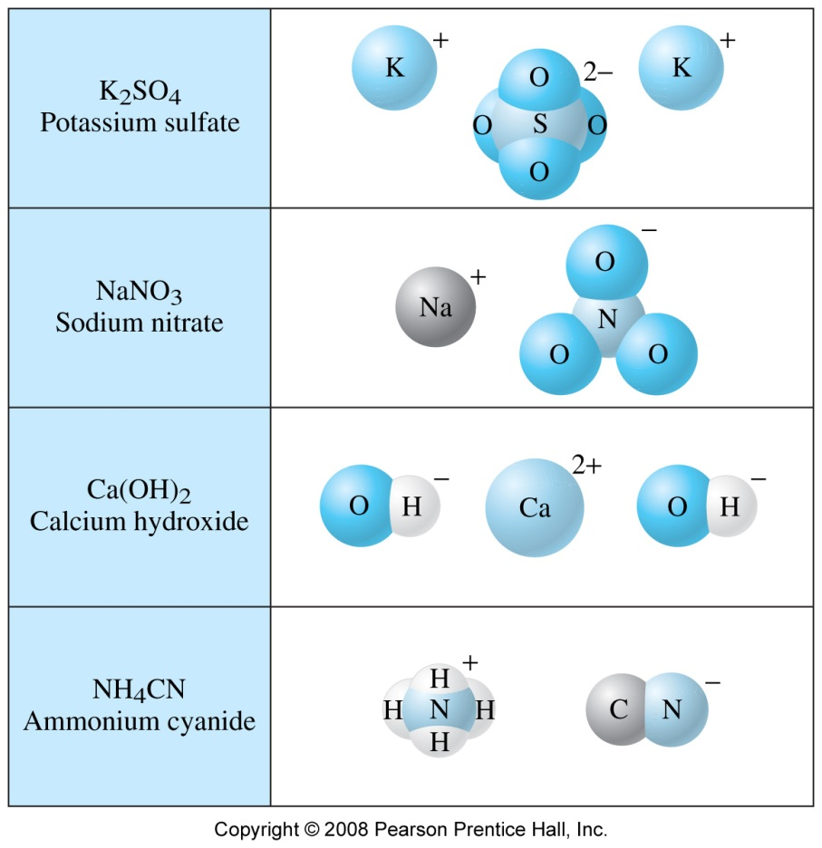
Polyatomic Ions
There are some common ions formed from multiple atoms (poly-atomic) and are therefore viewed as a single unit.
Naming: Same rules as metal/non-metal compounds, but you keep the polyatomic ions name

Slide 29
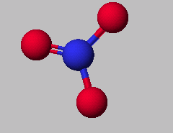
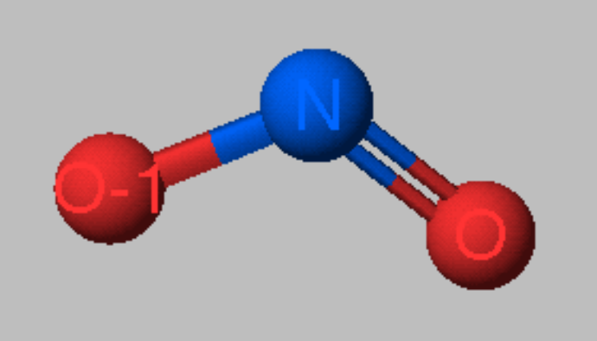
Polyatomic Ions
NO₃⁻
nitrate ion
NO₂⁻
nitrite ion

Slide 30
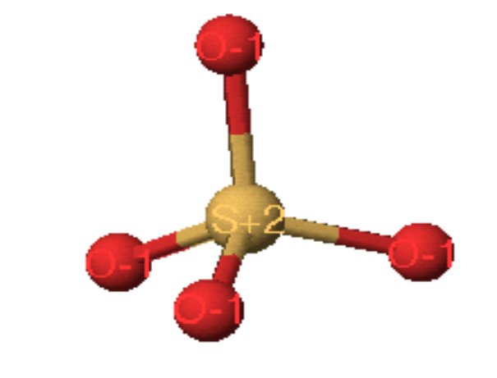
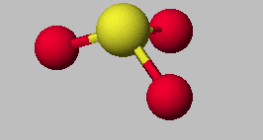
Polyatomic Ions
SO₄²⁻
sulfate ion
SO₃²⁻
sulfite ion

Slide 31
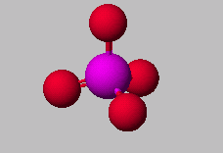
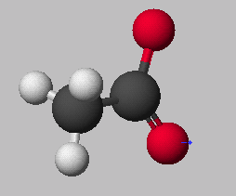
Polyatomic Ions
PO₄³⁻
phosphate ion
CH₃CO₂⁻
acetate ion
C₂H₃O₂⁻

Slide 32
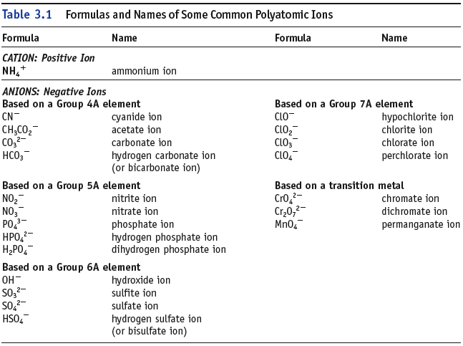
Note: many O containing anions have names ending in –ate (or -ite).

Slide 33
Ionic compounds of polyatomic ions
Naming
(Examples)
Same rules as metal/non-metal compounds, but you keep the polyatomic ions name:
KMnO₄ – potassium permanganate
Fe(NO₃)₃ – iron (III) nitrate
Mg(ClO)₂ – magnesium hypochlorite

Slide 34
Example – Writing Formula for Ionic Compounds Containing Polyatomic Ion
Iron(III) phosphate
Write the symbol for the cation and its charge
Write the symbol for the anion and its charge
Charge (without sign) becomes subscript for other ion
Reduce subscripts to smallest whole number ratio
Check that the total charge of the cations cancels the total charge of the anions
Fe⁺³
PO₄³⁻
Fe⁺³ PO₄³⁻
Fe₃(PO₄)₃
FePO₄
Fe = (1)∙(+3) = +3
PO₄ = (1)∙(-3) = -3

Slide 35
Practice - What are the formulas for compounds made from the following ions?
aluminum ion with a sulfate ion
chromium(II) with hydrogen carbonate

Slide 36
Practice - What are the formulas for compounds made from the following ions?
Al⁺³ with SO₄²⁻ Al₂(SO₄)₃
Cr⁺² with HCO₃ Cr(HCO₃)₂

Slide 37
Name the following
NH₄Cl
Ca(C₂H₃O₂)₂
Cu(NO₃)₂

Slide 38
Name the following
NH₄Cl ammonium chloride
Ca(C₂H₃O₂)₂ calcium acetate
Cu(NO₃)₂ copper(II) nitrate

Slide 39
Compare the elements Na, B, Al, and C with regard to the following properties:
Which has the largest (most positive) ionization energy?
10
Na
B
Al
C
0
of
5

Slide 40
Compare the elements Na, B, Al, and C with regard to the following properties:
Which has the largest (most negative) electron affinity?
10
Na
B
Al
C
0
of
5

